Slide 1

A Distributed Mutual Exclusion Algorithm for Mobile Ad-Hoc Networks
Name :- Abhishikth Boda
Roll Number :- S20210010044
Citation :- Richard Koo and Sam Toueg. 1985. Checkpointing and Rollback-Recovery for Distributed Systems. Technical Report. Cornell University, USA.

Slide 2
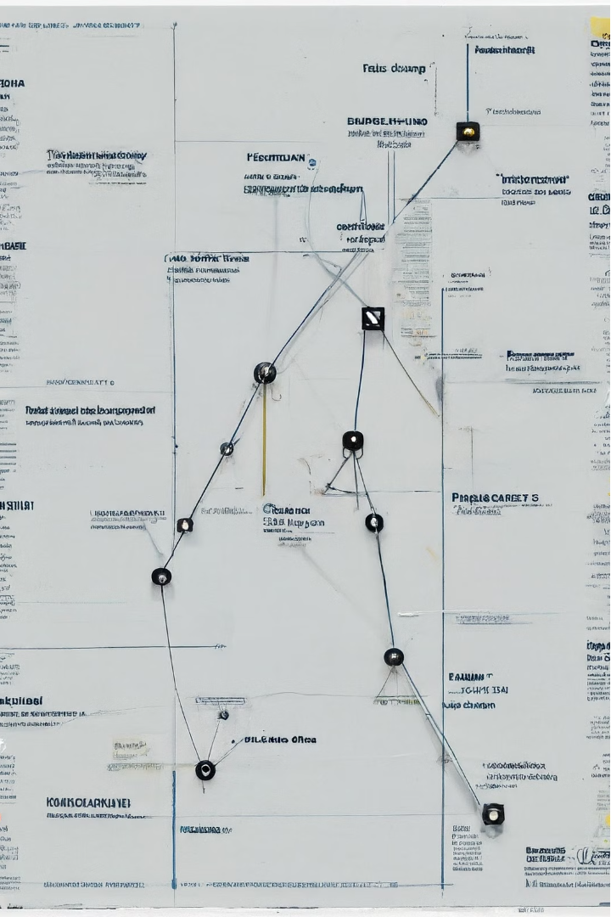
Introduction
This presentation explores a distributed mutual exclusion algorithm designed specifically for mobile ad-hoc networks (MANETs). MANETs are wireless networks composed of mobile devices that communicate over dynamic, unpredictable paths. Implementing distributed algorithms that ensure control and ordering, such as mutual exclusion, is a critical challenge in these networks. The algorithm presented in this paper aims to maintain low power consumption and adapt to the changing network topology, making it well-suited for the MANET environment.

Slide 3

Problem Statement
1
Distributed Mutual Exclusion in MANETs
2
Reducing Communication Overhead
3
Adapting to Mobility
The algorithm needs to adapt its behavior to changes in the physical network topology caused by node mobility, ensuring reliable communication even as paths between nodes change frequently.
Ensuring that only one process can access a shared resource at a time (mutual exclusion) is a fundamental problem in distributed systems. This is particularly challenging in mobile ad-hoc networks due to the dynamic network topology and limited device power.
The algorithm must minimize the number of messages exchanged per critical section access to conserve device power and network resources.

Slide 4
Research Gaps Addressed
Token-Based Algorithms
Dynamic Logical Ring
Mobility-Aware Design
The proposed algorithm belongs to the token-based family of distributed mutual exclusion algorithms. However, it combines the best features of both token-asking and logical ring approaches to achieve optimal performance under heavy request load.
Unlike previous logical ring algorithms, the logical ring in this algorithm is built dynamically on-the-fly, allowing it to adapt to the changing network topology in a mobile environment.
The algorithm explicitly considers node mobility and uses information from the routing protocol to make decisions that reduce the number of hops per message, further improving power efficiency.

Slide 5

Proposed Approach
1
Idle State
The algorithm starts in the Idle state, where the current coordinator process waits for requests to access the critical section. When requests are pending, the algorithm transitions to the Coordinator-Change state.
2
Coordinator-Change State
In this state, the algorithm executes a round of a dynamic logical ring, passing a token around to inform processes of the new coordinator and allow pending requests to be served.
3
Logical Ring Construction
The logical ring is built on-the-fly, with each process selecting its successor in the ring based on a policy that considers the number of hops to other processes. This allows the ring to adapt to the changing network topology.

Slide 6
Experimental Results
Baseline Algorithms
Optimality under Heavy Load
Reduced Hops per Message
The proposed algorithm was compared to other token-based distributed mutual exclusion algorithms, including classic token-asking and logical ring approaches, to evaluate its performance.
The simulation results showed that the proposed algorithm achieves optimal performance, with the number of messages per critical section access approaching the theoretical minimum of two, when the request load is heavy.
By leveraging information from the routing protocol to construct the dynamic logical ring, the algorithm was able to reduce the average number of hops per message, leading to improved power efficiency in the mobile network.

Slide 7
Key Concepts and Algorithms
Token-Based Approach
Dynamic Logical Ring
The algorithm belongs to the token-based family of distributed mutual exclusion algorithms, where a process can enter the critical section only when it holds the token.
The algorithm structures the processes into a logical ring that is built dynamically on-the-fly, allowing it to adapt to changes in the network topology.
Coordinator-Change State
Successor Selection Policy
The algorithm alternates between an Idle state and a Coordinator-Change state, where a round of the logical ring is executed to inform processes of the new coordinator and serve pending requests.
The policy used to select the successor in the logical ring is based on the number of hops to other processes, as determined by the underlying routing protocol, to minimize the number of hops per message.

Slide 8



Formal Analysis
Mutual Exclusion
Deadlock Freedom
Starvation Freedom
The algorithm ensures mutual exclusion by allowing only the process holding the token to enter the critical section.
The algorithm is deadlock-free, as the token is always eventually passed to a process that can receive it, even in the presence of node mobility and temporary disconnections.
The algorithm guarantees starvation freedom, as requests are served in the order determined by the serialization policy, ensuring that no process is indefinitely denied access to the critical section.

Slide 9



Open Problems
Optimal Serialization Policy
Handling Network Partitions
Security Considerations
The current algorithm does not address security concerns, such as protecting against malicious nodes or ensuring the integrity of the token. Incorporating security features would be an important direction for future work.
The current serialization policy based on hop count is a simple heuristic. Investigating more sophisticated policies that consider other factors, such as device energy levels or application-specific priorities, could further improve the algorithm's performance.
The algorithm assumes the network is not subject to permanent partitions. Extending the approach to handle such scenarios, potentially by incorporating mechanisms for dynamic token replication or partition detection, could broaden its applicability.

Slide 10
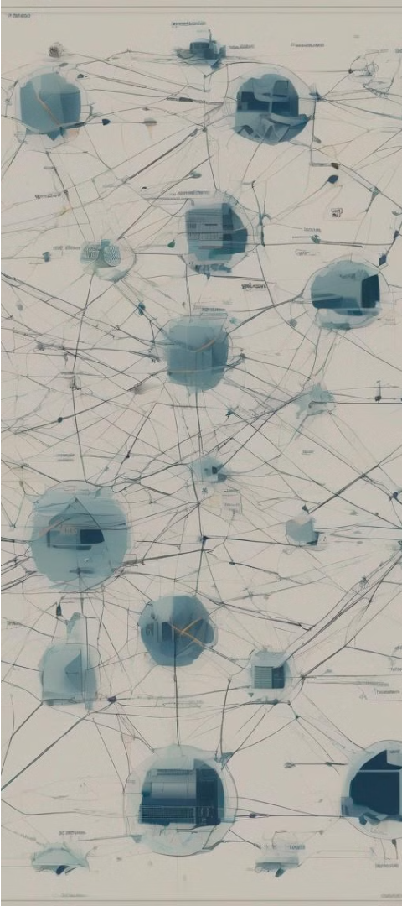
Conclusion and Future Work
Conclusion
Future Work
The proposed distributed mutual exclusion algorithm for mobile ad-hoc networks combines the strengths of token-based approaches to achieve optimal performance under heavy request load. By dynamically constructing a logical ring and leveraging routing information, the algorithm effectively adapts to the changing network topology while minimizing power consumption.
Future research directions include investigating more advanced serialization policies, extending the algorithm to handle network partitions, and incorporating security features to address potential threats in the mobile ad-hoc environment.

Slide 11
References
[1] Badrinath, B. R., Acharya, A., & Imielinski, T. (1993). Impact of mobility on distributed computations. ACM SIGOPS Operating Systems Review, 27(2), 15-20.
[2] Singhal, M. (1989). A taxonomy of distributed mutual exclusion. Journal of Parallel and Distributed Computing, 18(1), 94-101.
[3] Ricart, G., & Agrawala, A. K. (1981). An optimal algorithm for mutual exclusion in computer networks. Communications of the ACM, 24(1), 9-17.
[4] Raymond, K. (1989). A tree-based algorithm for distributed mutual exclusion. ACM Transactions on Computer Systems (TOCS), 7(1), 61-77.

